Slide 1



Data Analysis Fundamentals Lecture 2: Understanding of Data
Vikas Kumar
Indian Institute of Technology Bombay
05th September 2023

Slide 2
Outline
Understanding phases of a typical Data Analytics Project
Understanding Data
Derived Facts/Dimensions
Building dimensions from Facts (Binning)
Granularity of Data

Slide 3
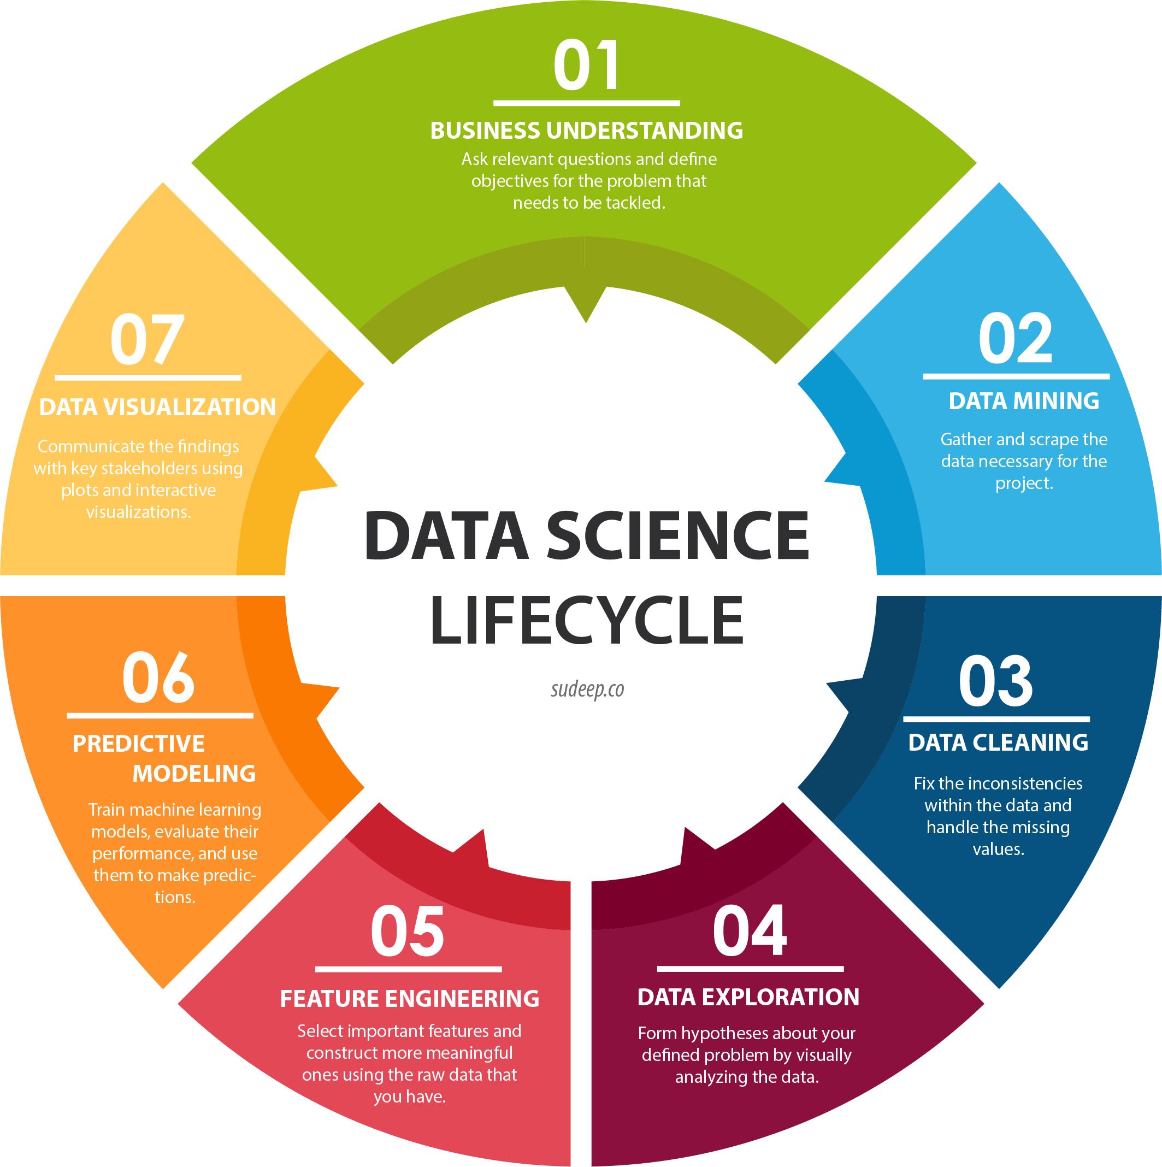
Data Science/Analysis Pipeline

Slide 4
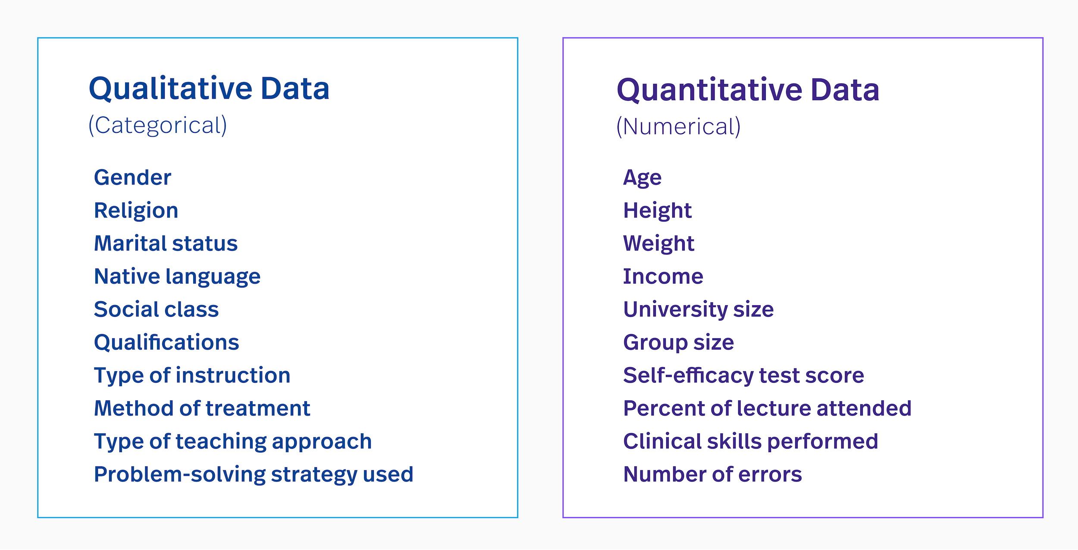
Understanding Data

Slide 5
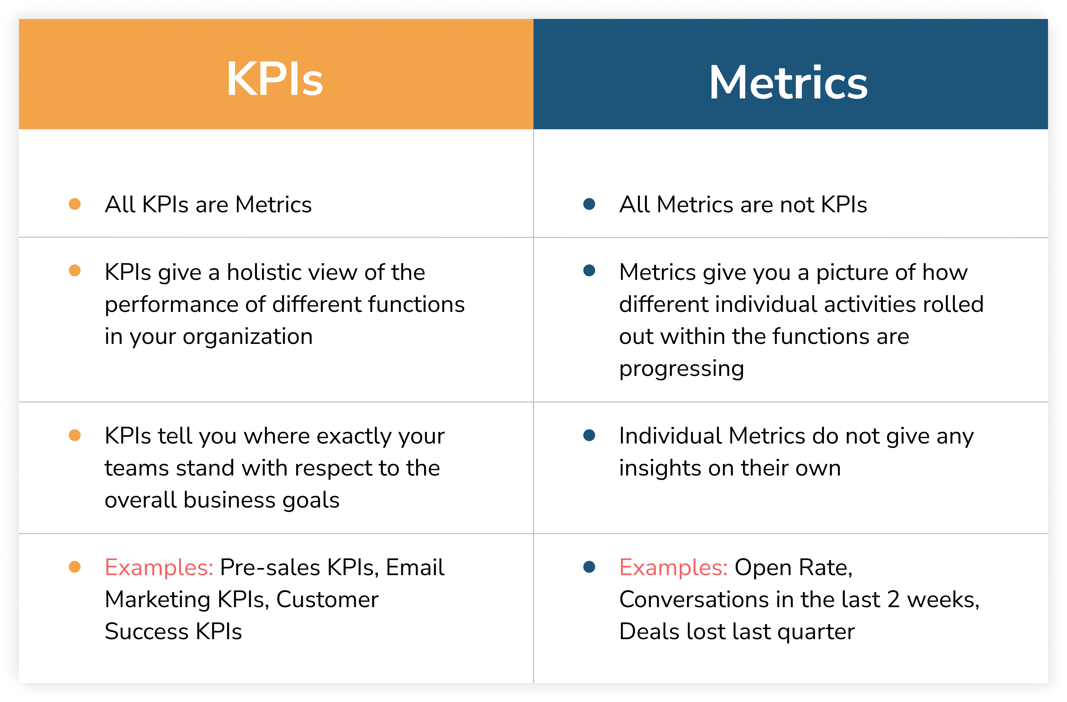
Quantitative Data/Facts/Metrics/Measures/KPIs

Slide 6
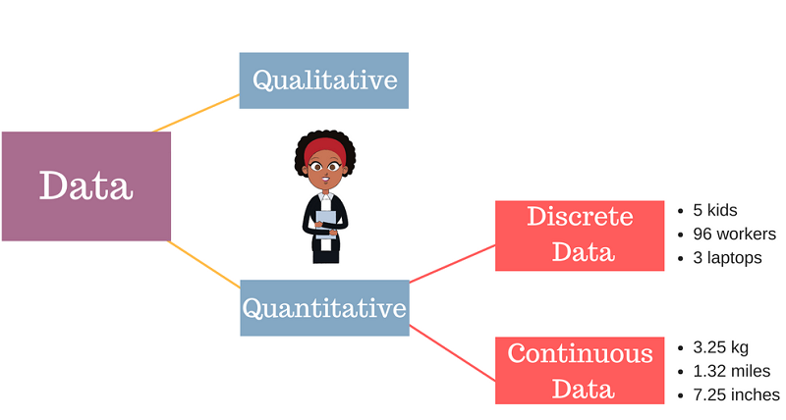
Continuous vs Discrete data

Slide 7
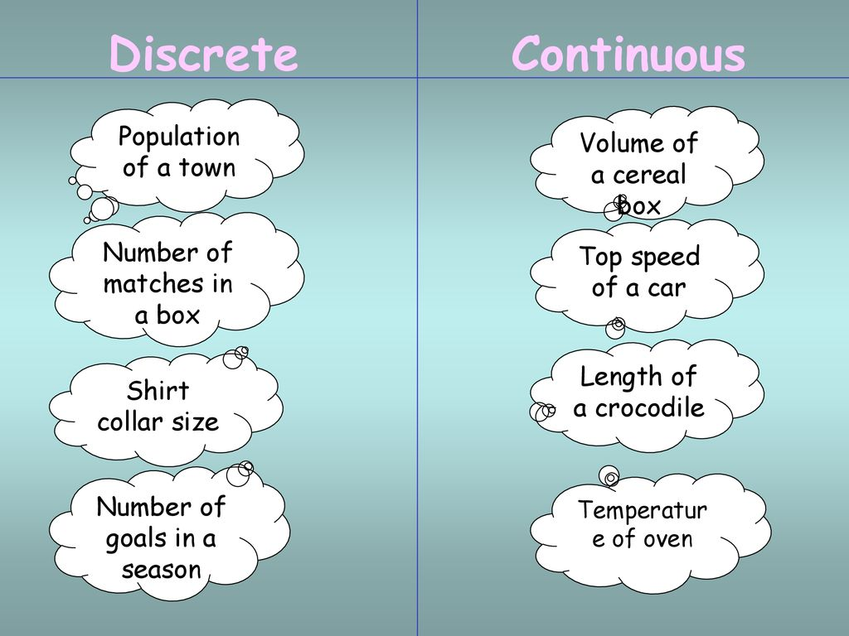
Continuous vs Discrete data
Discrete data is a finite value that can be counted.
Continuous data has an infinite number of possible values that can be measured.

Slide 8
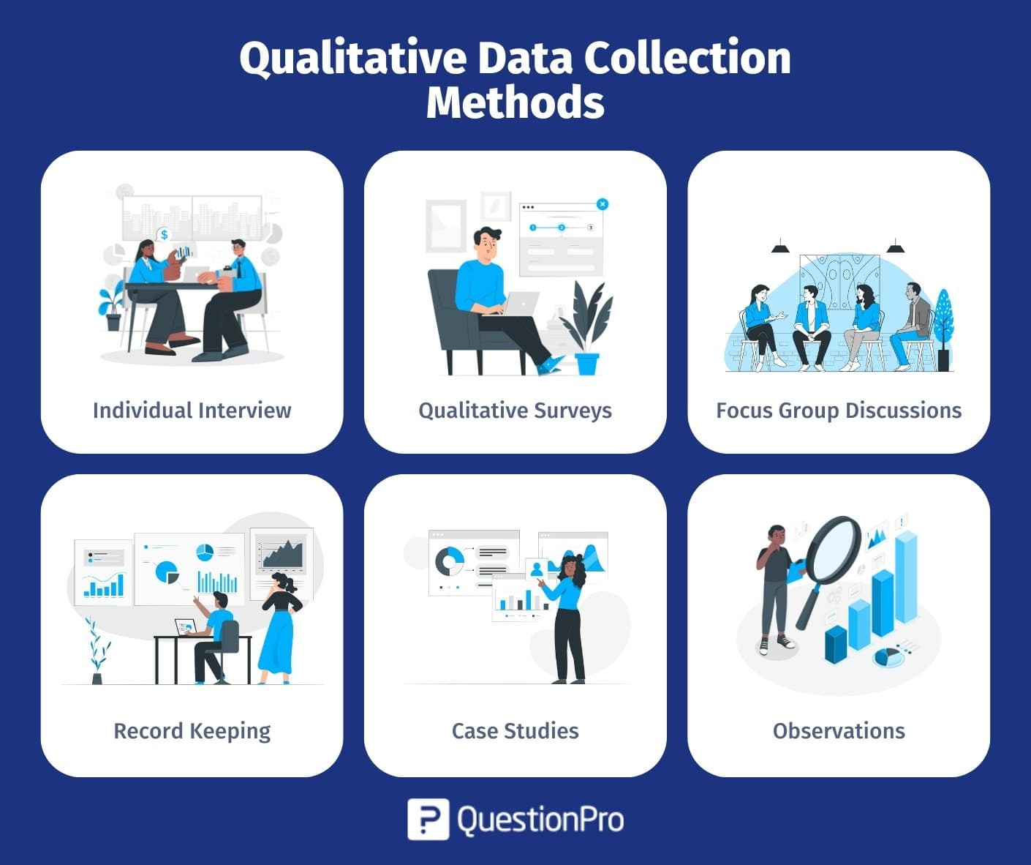
Qualitative Data/Dimensions/Perspectives/Slicers

Slide 9
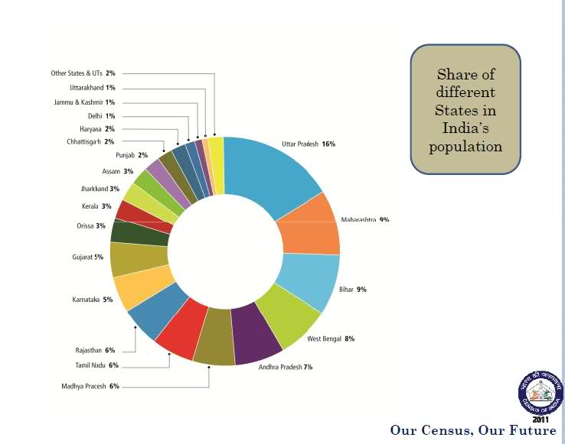
Qualitative Data/Dimensions/Perspectives/Slicers

Slide 10
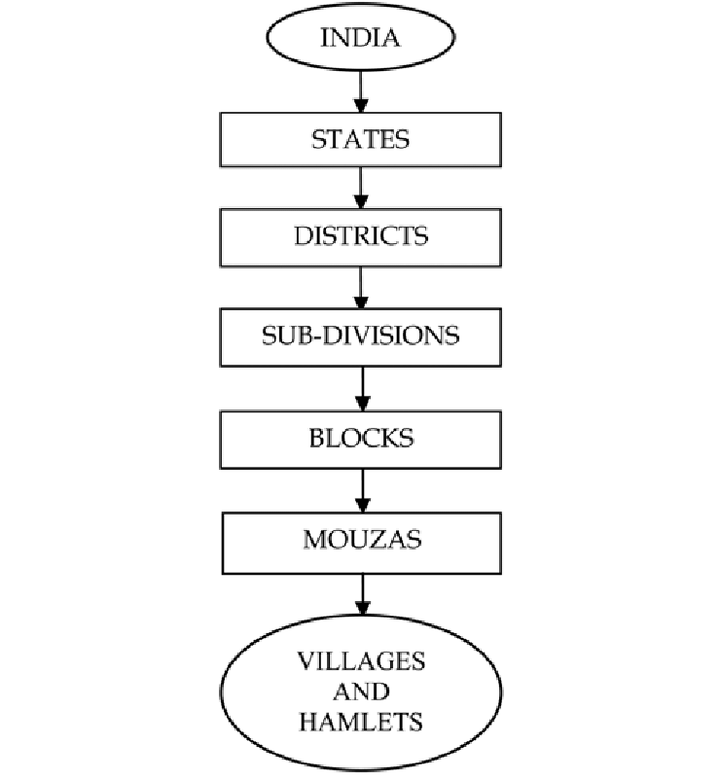
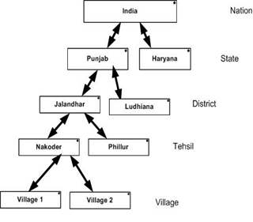
Hierarchical Dimensions

Slide 11
Derived Facts/Dimensions
In data warehousing, facts and dimensions are standard terms.
They inform us about things like the number of resources used for a particular task.
They both store the exact measure of resources and details about the resource and task.
A fact in data warehousing describes quantitative transactional data like measurements, metrics, or values ready for analysis.
Dimensions are companions to facts and are attributes of facts like the date of a sale.

Slide 12
Building Dimensions from Facts (Binning)
Data binning, also called discrete binning or bucketing, is a data pre-processing technique that reduces the effects of minor observation errors.
The original data values are divided into small intervals known as bins, and then they are replaced by a general value calculated for that bin.
Data binning is a way to group numbers of more or less continuous values into a smaller number of "bins".

Slide 13
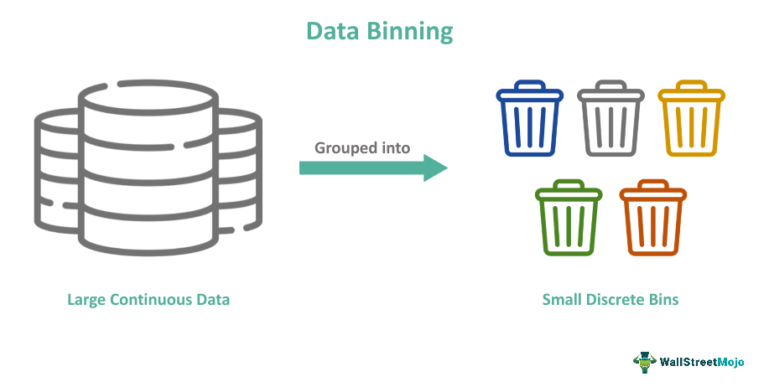
Building Dimensions from Facts (Binning)

Slide 14
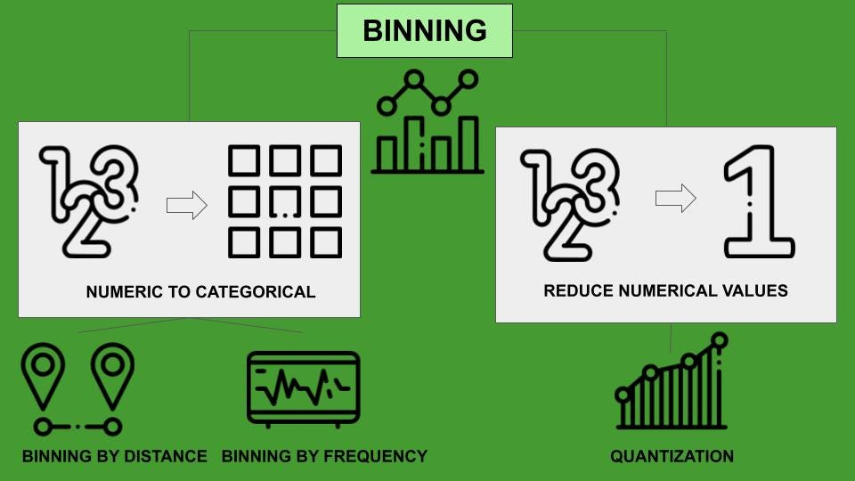
Building Dimensions from Facts (Binning)

Slide 15
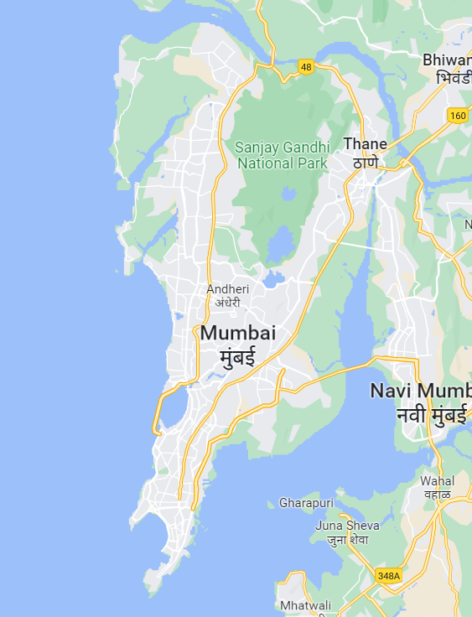
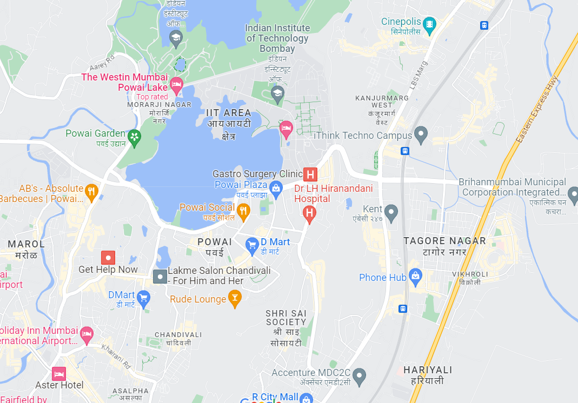
Granularity of Data
Data granularity measures the level of detail in a data structure.
In time-series data, for example, the granularity of measurement might be based on intervals of years, months, weeks, days, or hours.

Slide 16
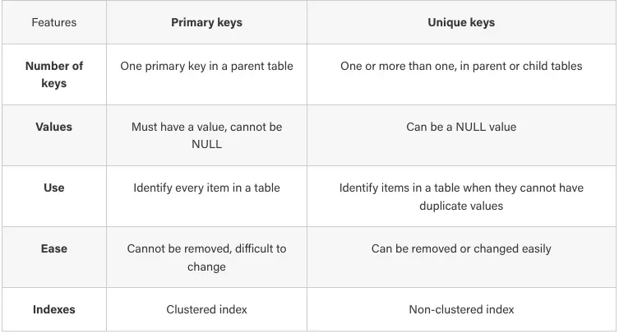
Identifying/Constructing unique keys

Slide 17
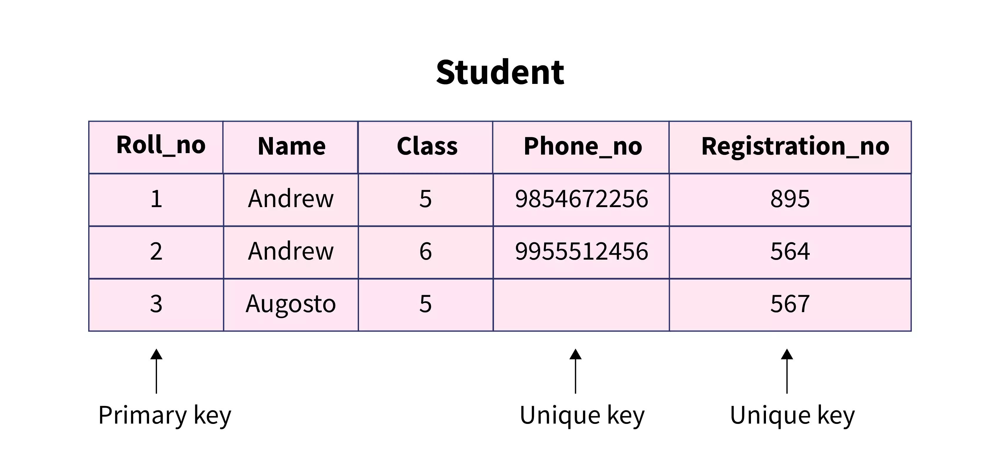
Identifying/Constructing unique keys

Slide 18


